Slide 1


Evolutionary Optimization,
Learning and Adaptive
Systems
23CSE399-Final Year Project
Presented by: Neelam Naga Naren Tejesh
Kolla Girish
Ande Taraka Srinivas
D S Vasishta
N Adarsh
Date: 15th Dec, 2025

Slide 2

EvOLve
Evolutionary Optimization, Learning and Adaptive Systems (EvOLve) is a computational paradigm inspired by natural evolution and biological adaptation, where systems improve their performance through continuous interaction with their environment.
EvOLve focuses on how intelligent systems can learn, adapt, and optimize solutions over time without relying on explicit programming rules. Instead, solutions evolve based on performance feedback, enabling the system to handle complex, dynamic, and uncertain problem spaces.
This approach is particularly effective in scenarios where traditional optimization techniques fail due to non-linearity, large search spaces, or changing constraints.

Slide 3
Key Projects
1.⁠ ⁠Genetic Programming
2.⁠ ⁠Ant colony optimization
3.⁠ ⁠Particle Swarn Optimization
4.⁠ ⁠Differential Algorithm
5.⁠ ⁠Genetic Algorithm

Slide 4
Genetic Programming
3
Minimal Human Design Effort
1
Unlike traditional programming, GP does not require explicit rules or predefined models. The system discovers the program logic on its own, making it suitable for problems where the exact solution form is unknown.
Programs as Solutions
Genetic Programming evolves entire computer programs or mathematical expressions (usually represented as tree structures) instead of fixed parameters. Each evolved program represents a possible solution to the problem.
2
Automatic Program Evolution
GP starts with randomly generated programs and automatically improves them over generations by evaluating their performance on a task and modifying their structure to produce better programs.

Slide 5

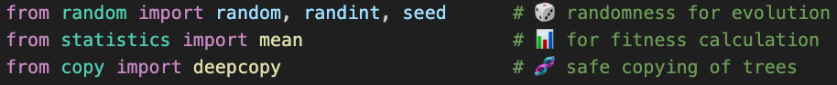
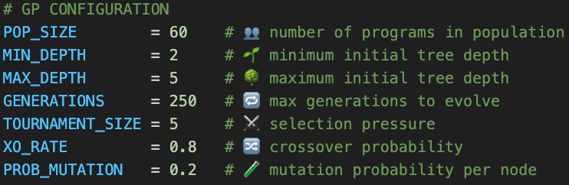
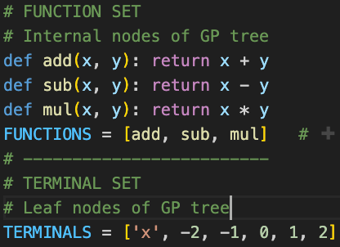
CODE:

Slide 6
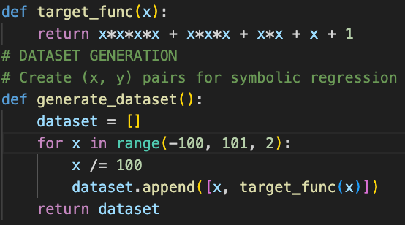
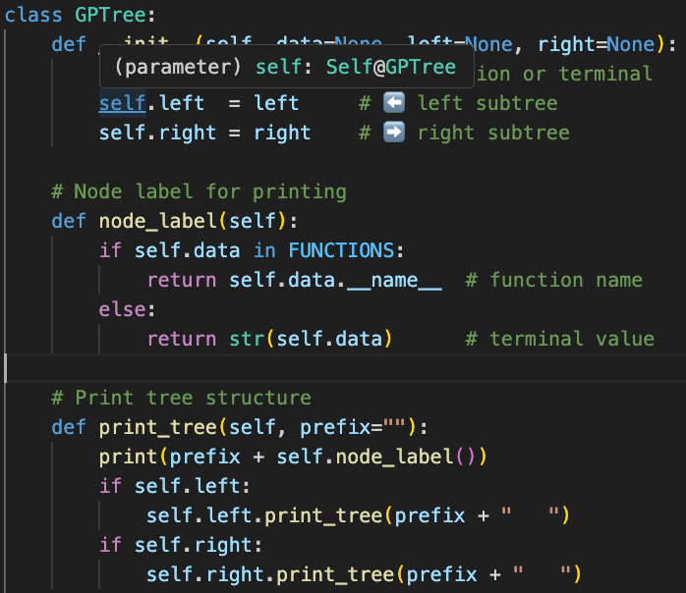
CODE:

Slide 7
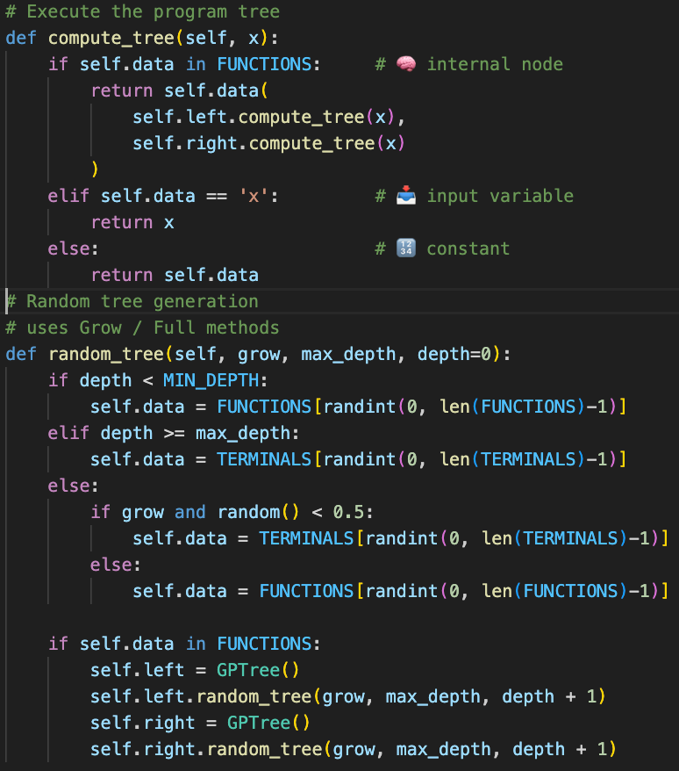
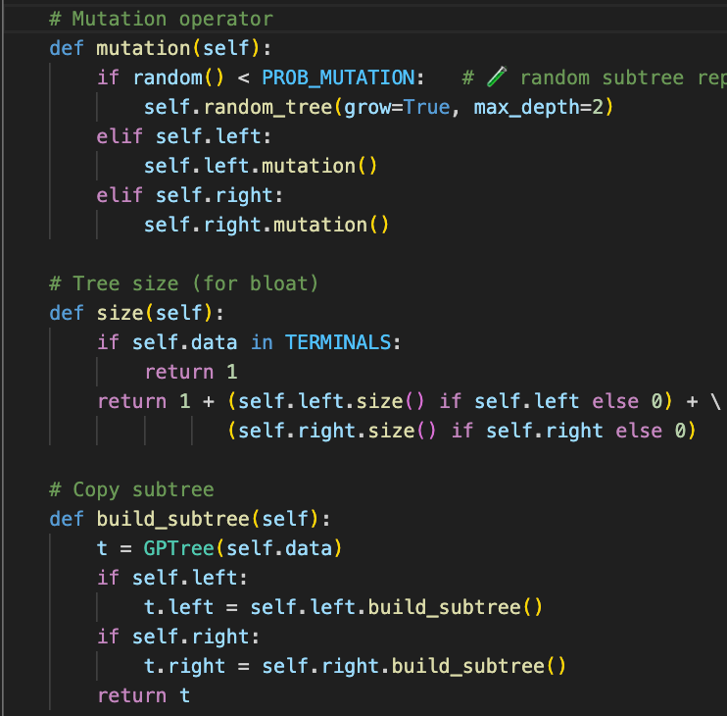
CODE:

Slide 8
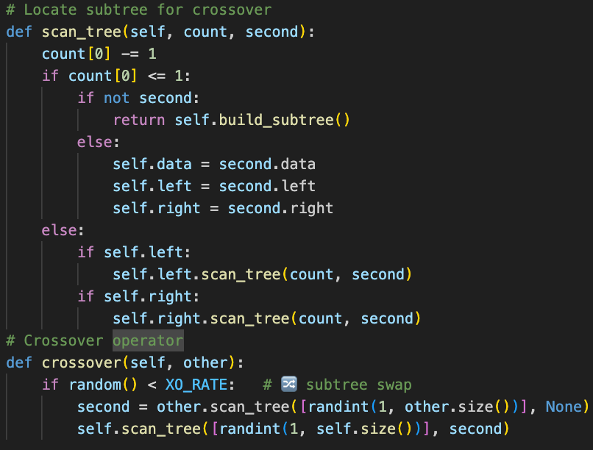
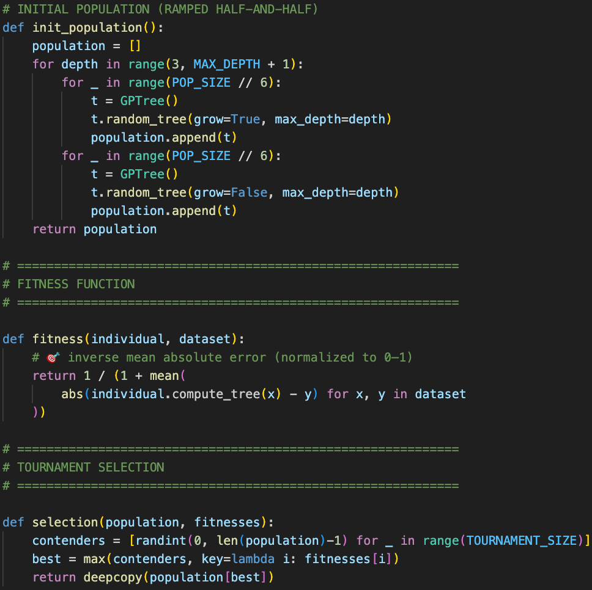
CODE:

Slide 9
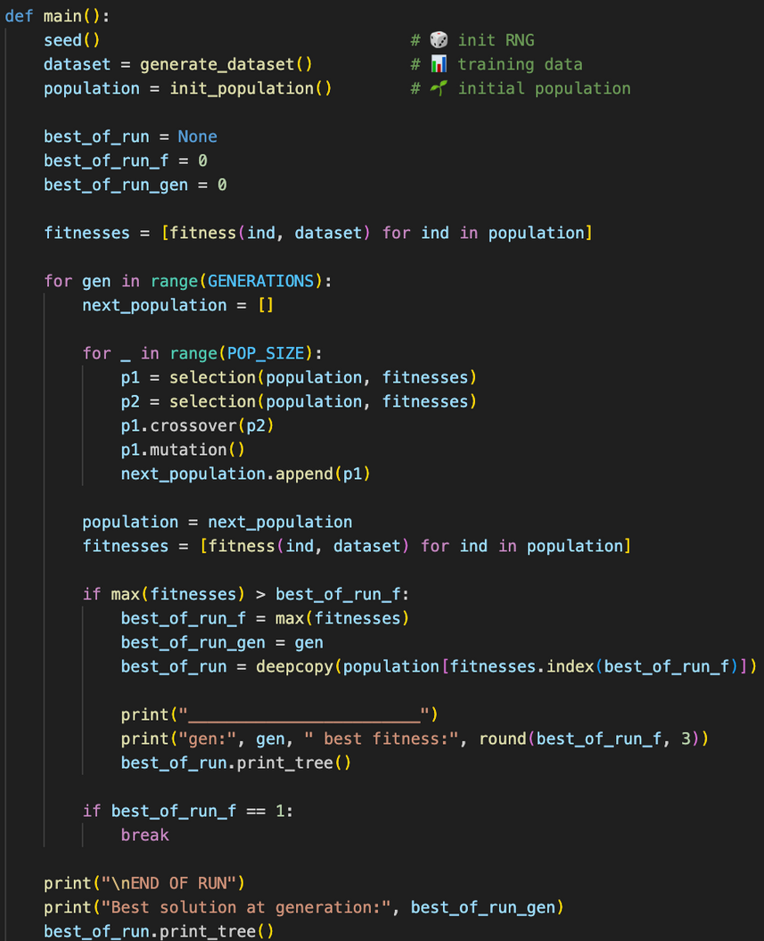
CODE:

Slide 10
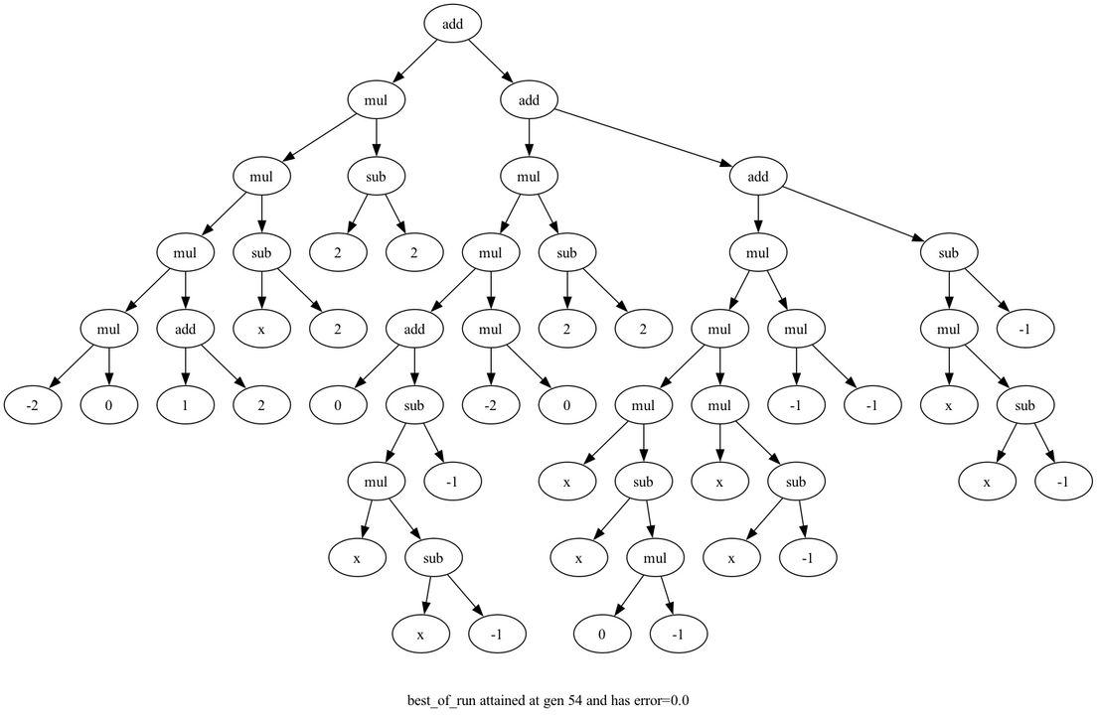
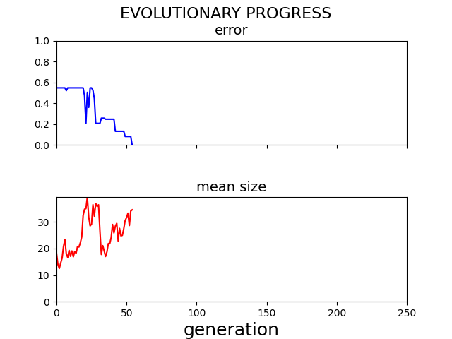
OUTPUT:

Slide 11
ANT COLONY OPTIMIZATION
2
Solutions as Paths
In ACO, each ant represent candidate solution that is constructed incrementally through a path-building process. At each step, the ant probabilistically selects the next component of the solution based on the intensity of pheromone trails (τ) and heuristic information (η), such as distance or cost, guiding the search toward better solutions.
1
How It Works
Ant Colony Optimization builds and improves solution paths using a group of artificial ants.
Each ant evaluates its solution and deposits pheromone to guide future ants.
Stronger paths are reinforced while weaker ones fade, enabling adaptive convergence to an optimal solution.
3
Probabilistic Decision Making
In ACO, each ant acts as a candidate solution and builds its solution step by step through a path construction process. At every step, the next component is chosen probabilistically based on the pheromone intensity (τ), which represents learned experience, and heuristic information (η), such as distance or cost, helping guide the ant toward better solutions

Slide 12
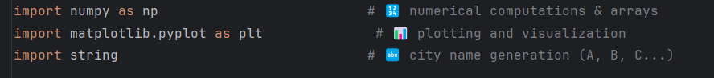
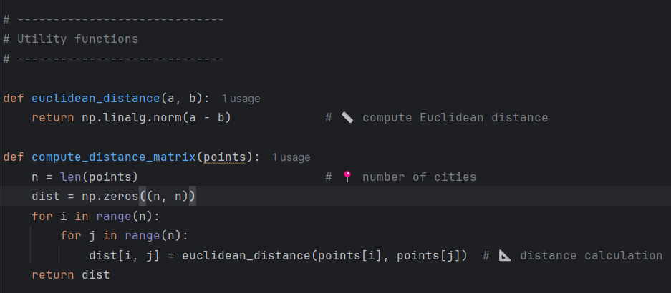
CODE:

Slide 13
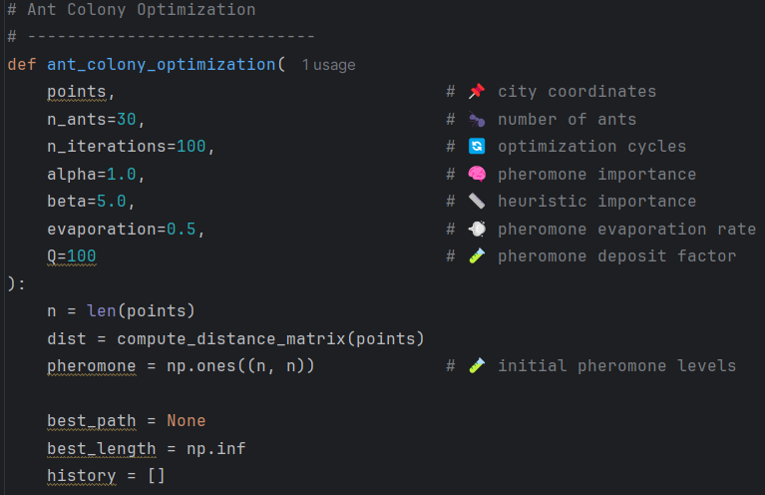
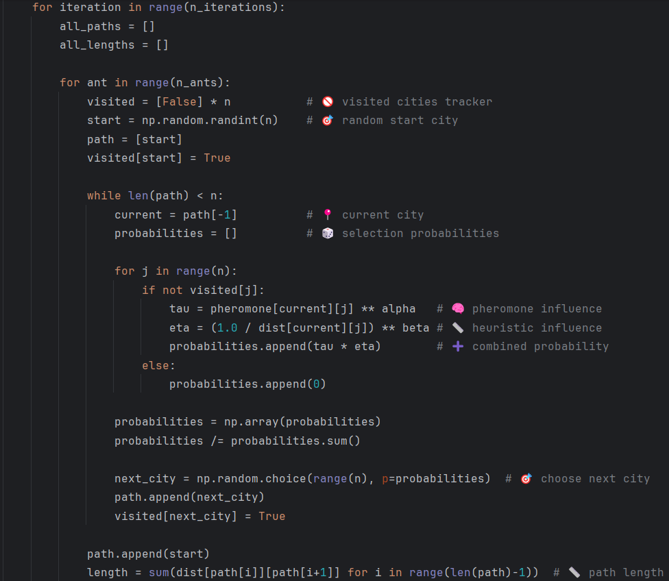
CODE:

Slide 14
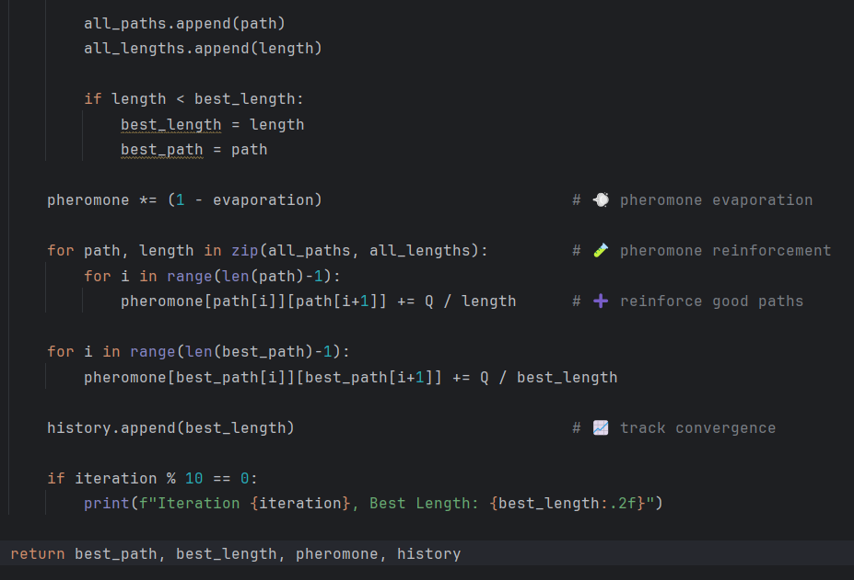
CODE:

Slide 15
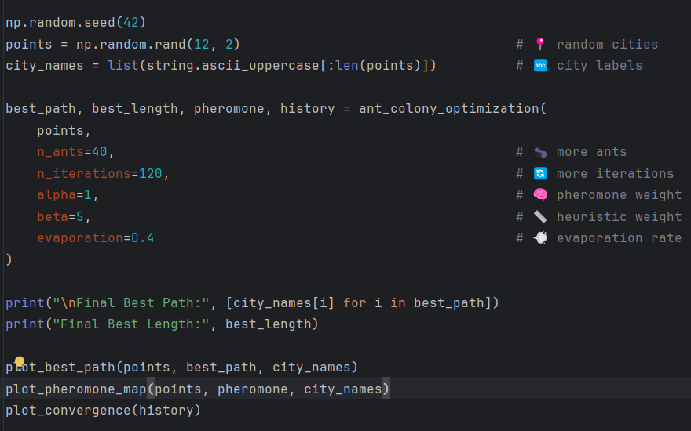
CODE:

Slide 16
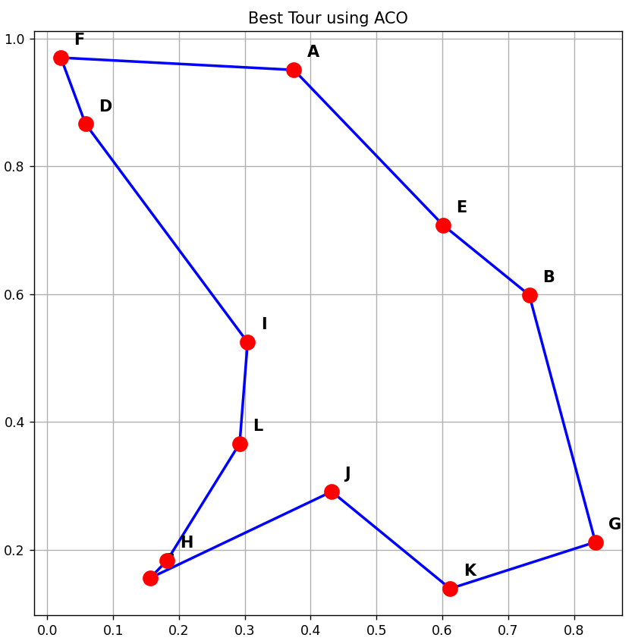
OUTPUT:

Slide 17
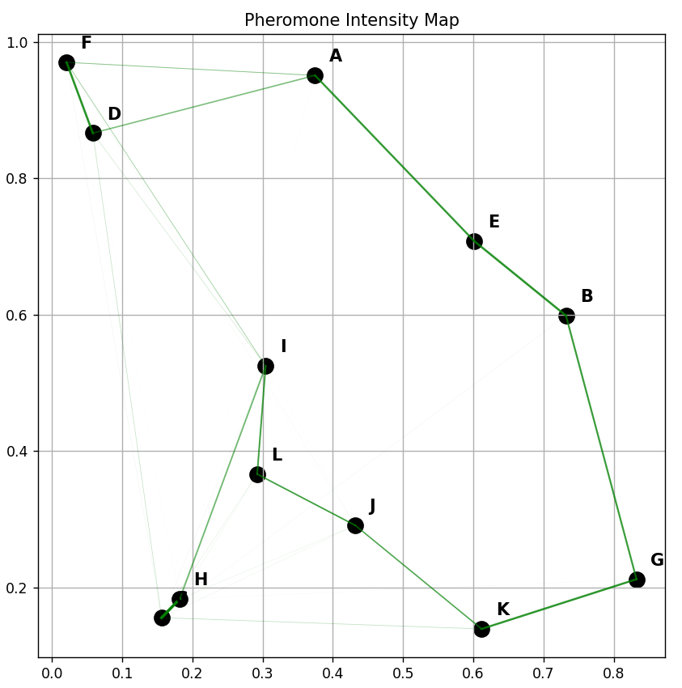
OUTPUT:

Slide 18
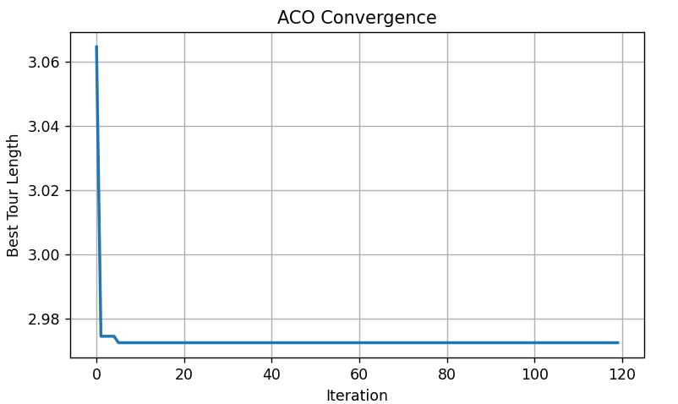
OUTPUT:

Slide 19
⁠Particle Swarm Optimization
3
Key Parameters & Features
w (Inertia Weight): controls exploration and exploitation
c1 (Cognitive Factor): self-learning component
c2 (Social Factor): swarm learning component
r1, r2: random values to maintain diversity
Simple structure with fast convergence
1
Algorithm Overview
Particle Swarm Optimization is a swarm intelligence–based optimization algorithm
Inspired by collective behavior of birds flocking
Uses a population of particles to search for the optimal solution
Each particle represents a candidate solution
2
PSO Update Equations
Velocity Update:
v(i) = Inertia part + Cognitive part + Social part
v(i) = w * v(i) + c1 * r1 * (pBest(i) - x(i)) + c2 * r2 * (gBest - x(i))
Position Update:
x(i) = x(i) + v(i)

Slide 20
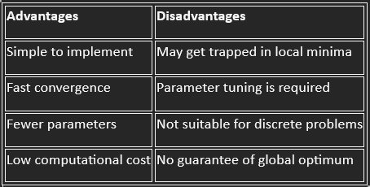
Advantages & Disadvantages

Slide 21
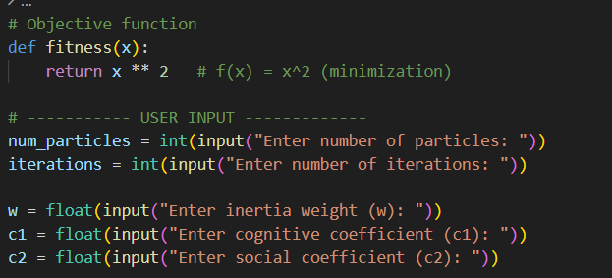
CODE:

Slide 22
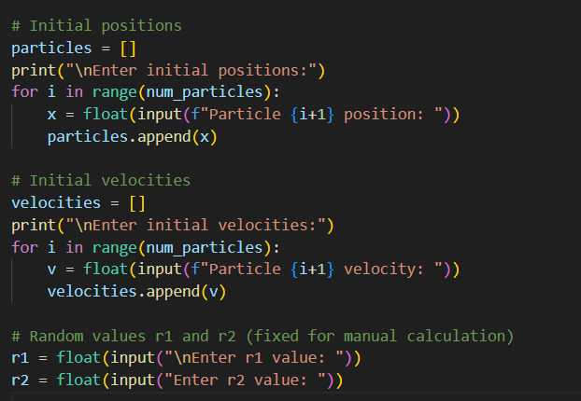
CODE:

Slide 23
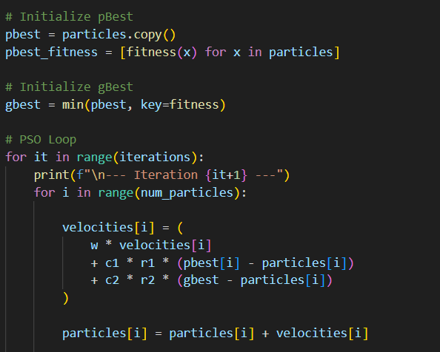
CODE:

Slide 24
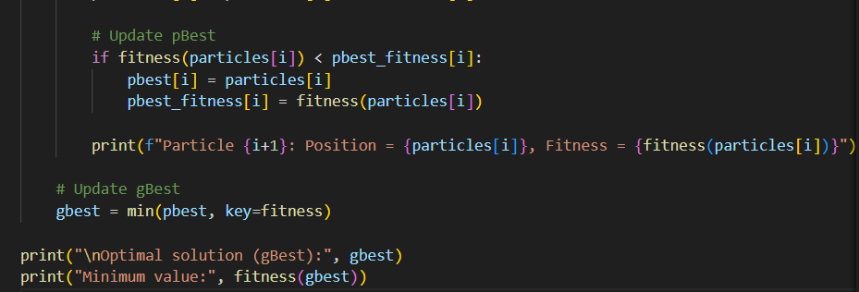
CODE:

Slide 25
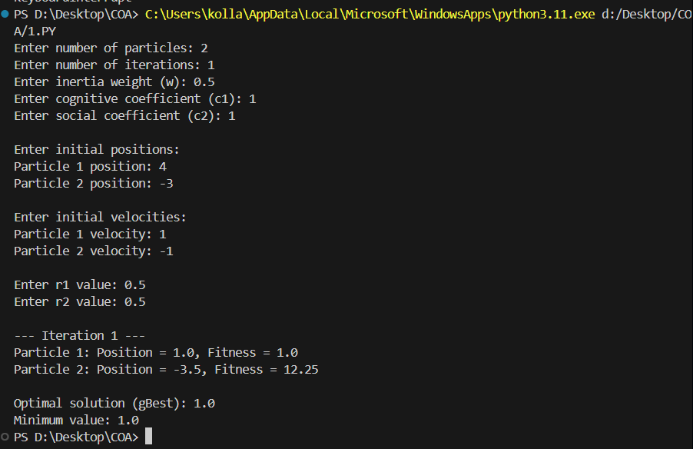
Output:

Slide 26
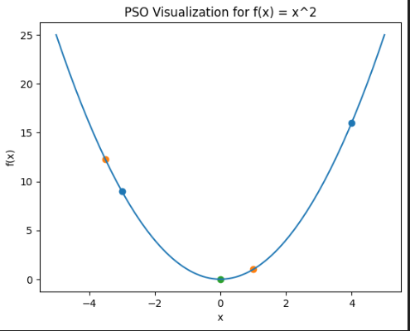
Output:

Slide 27
Differential
Algorithm
2
Mutation Using Differences
In Differential Evolution, mutation is performed by adding the scaled difference of two randomly selected solutions to a third solution. This difference-based mutation helps explore the search space efficiently and introduces diversity, enabling the algorithm to escape local optima.
1
How It Works
Differential Evolution is a population-based optimization algorithm used to solve continuous optimization problems. It starts with a group of candidate solutions and iteratively improves them using mutation, crossover, and selection. Over generations, weaker solutions are replaced by better ones, allowing the algorithm to converge toward the optimal solution.
3
Selection of Better Solutions
After mutation and crossover, a trial solution is compared with the current solution. If the trial solution produces a better fitness value, it replaces the current one. This greedy selection strategy ensures that the population continuously improves toward the global optimum.

Slide 28
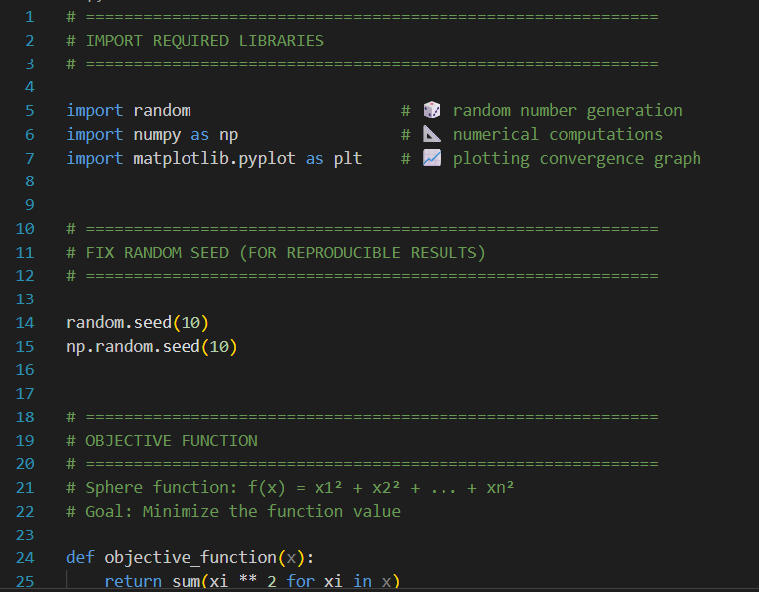
CODE:

Slide 29
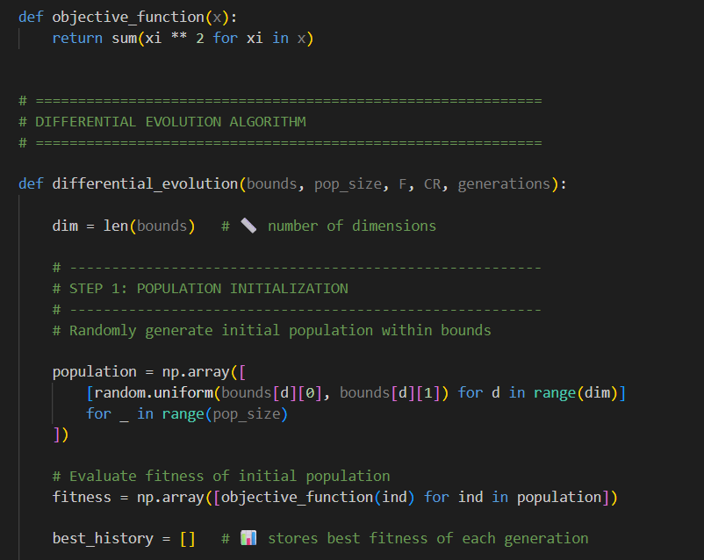
CODE:

Slide 30
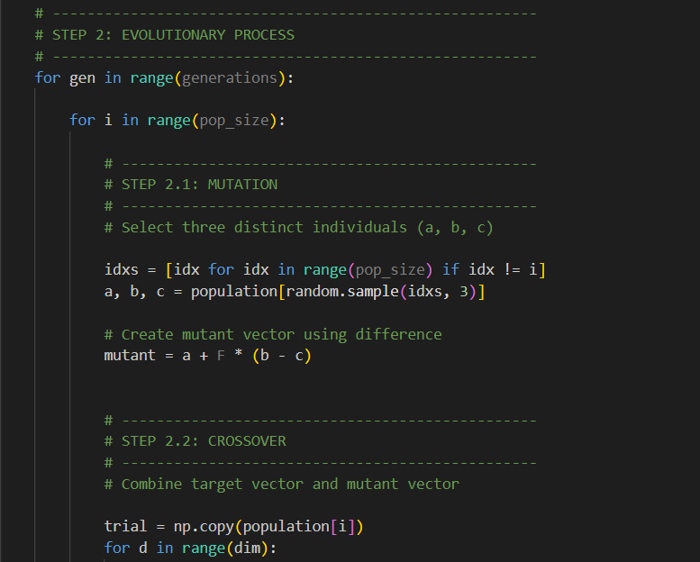
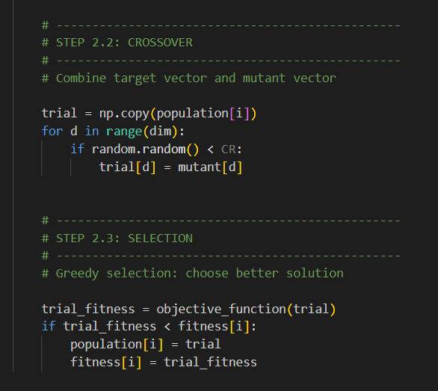
CODE:

Slide 31
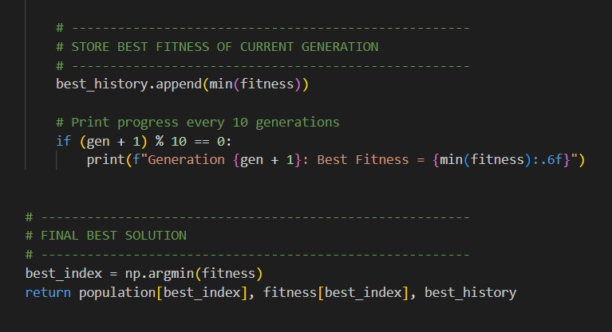
CODE:

Slide 32
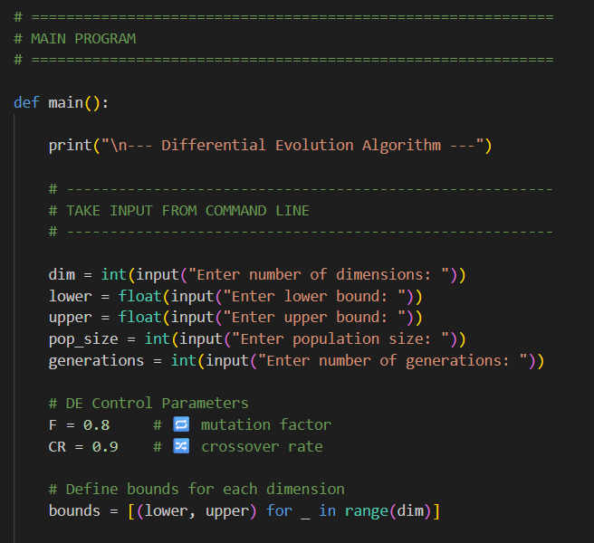
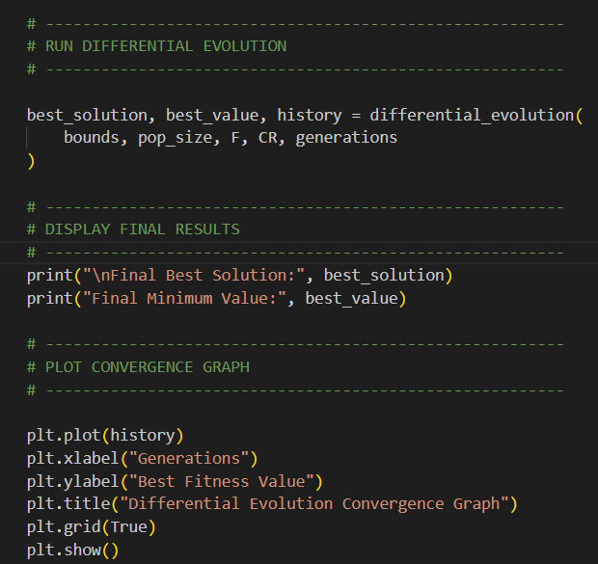
CODE:

Slide 33
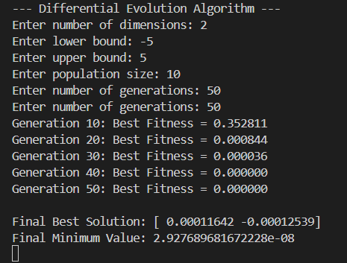
OUTPUT:

Slide 34
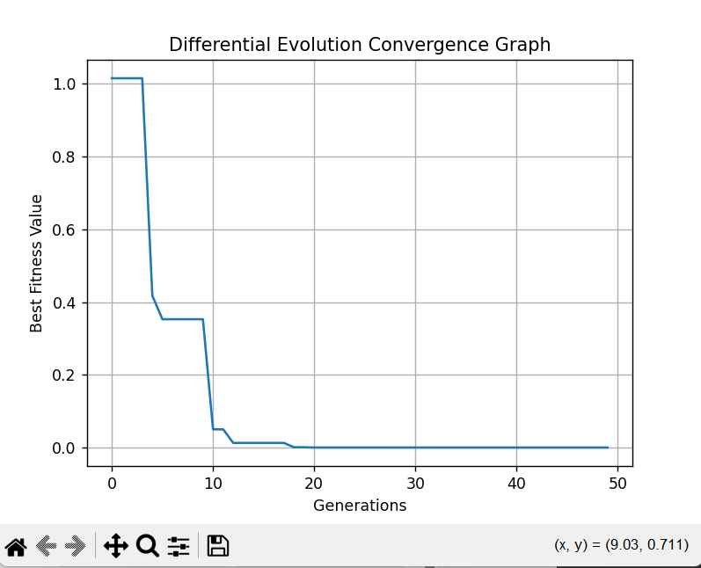
OUTPUT:

Slide 35
Genetic ALGORITHM
2
Population-Based Evolution
In Genetic Algorithms, each solution is represented as a chromosome made up of genes. The algorithm evolves an entire population of solutions, enabling parallel exploration of the search space. Fitter individuals are favored during selection, while crossover combines parent genetic material. Mutation introduces controlled randomness, maintaining diversity and balancing exploration and exploitation to prevent premature convergence.
1
How It Works
Genetic Algorithm is an evolutionary optimization technique inspired by natural selection. A population of candidate solutions (chromosomes) evolves over generations. Each individual is evaluated using a fitness function, and better-performing solutions are more likely to contribute genetic material to the next generation. Through iterative improvement, the population converges toward an optimal or near-optimal solution.
3
Automatic Program Evolution
Solutions evolve using three primary genetic operators: selection, which chooses parent solutions based on fitness; crossover, which recombines genes from two parents to generate offspring; and mutation, which randomly alters genes to maintain population diversity. Over successive generations, beneficial traits propagate throughout the population, guiding the search toward higher-quality solutions and robust optimization outcomes.

Slide 36
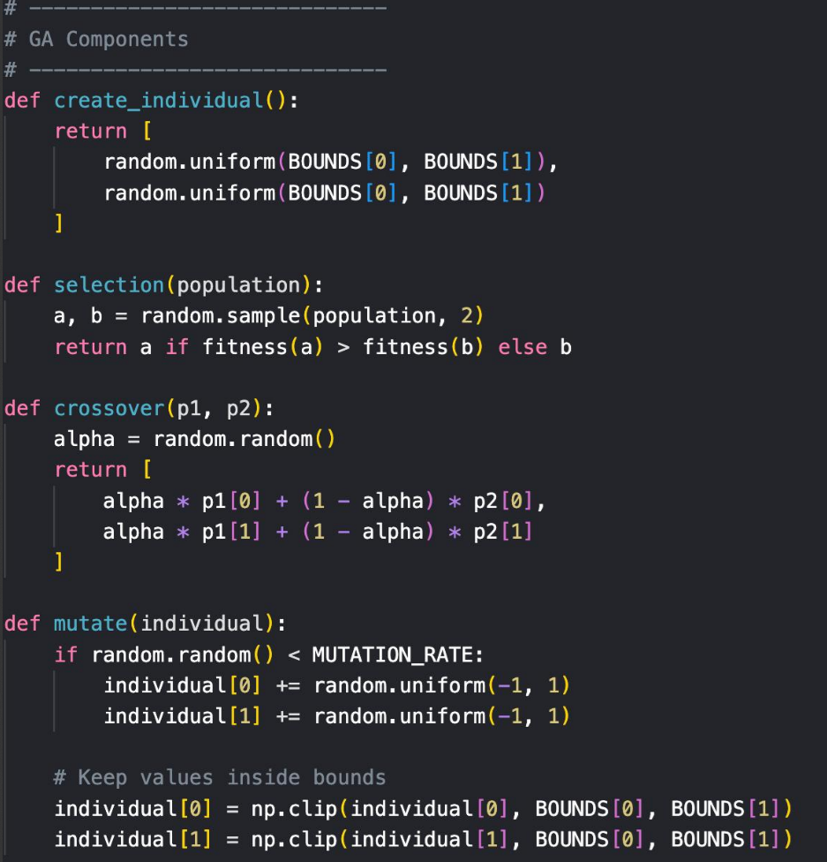
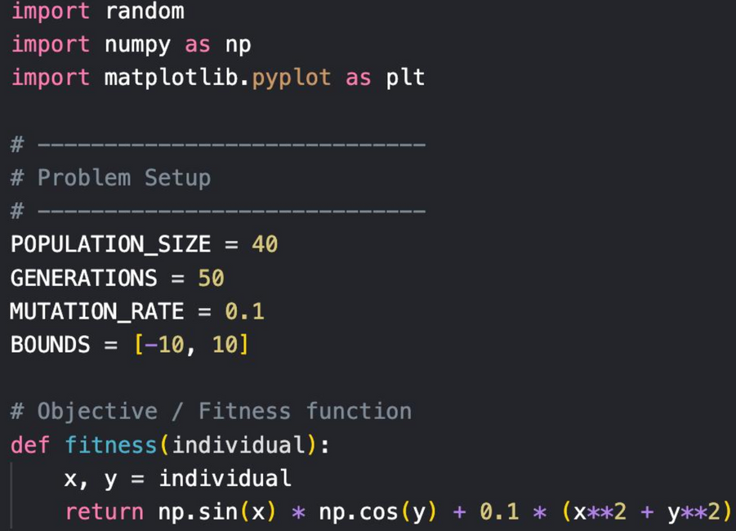
CODE:

Slide 37
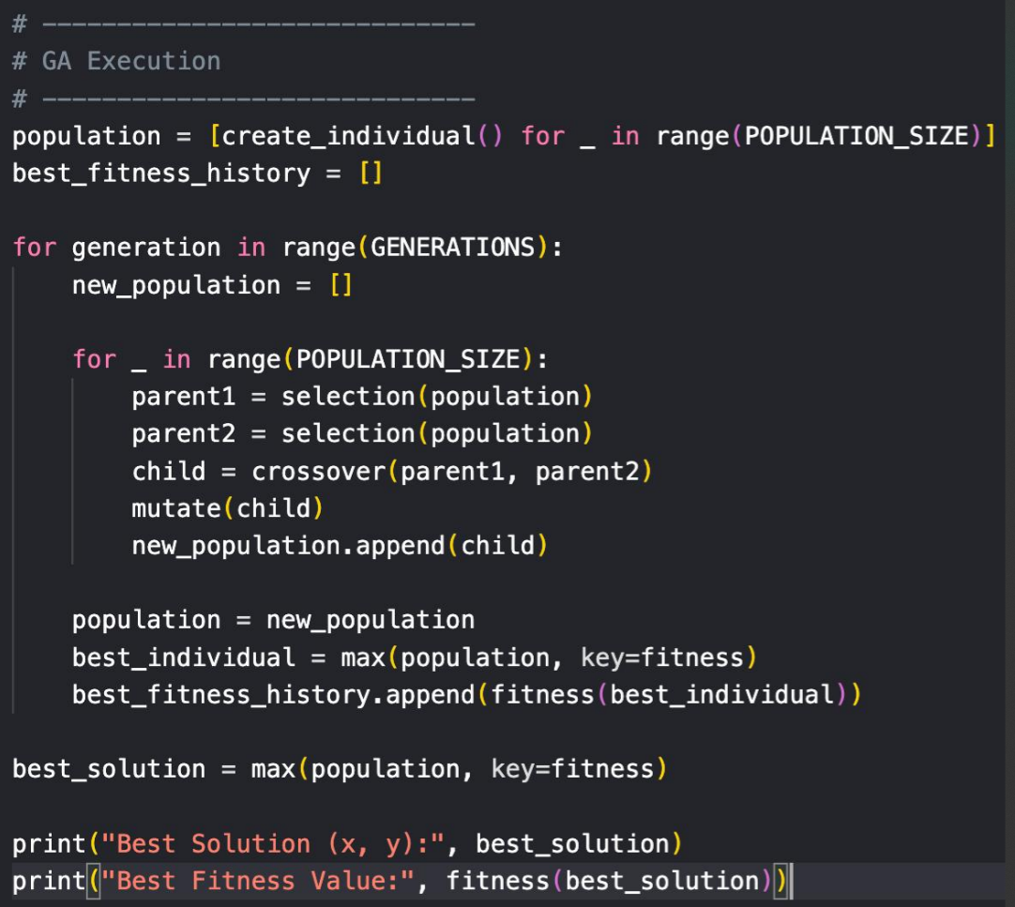
CODE:

Slide 38
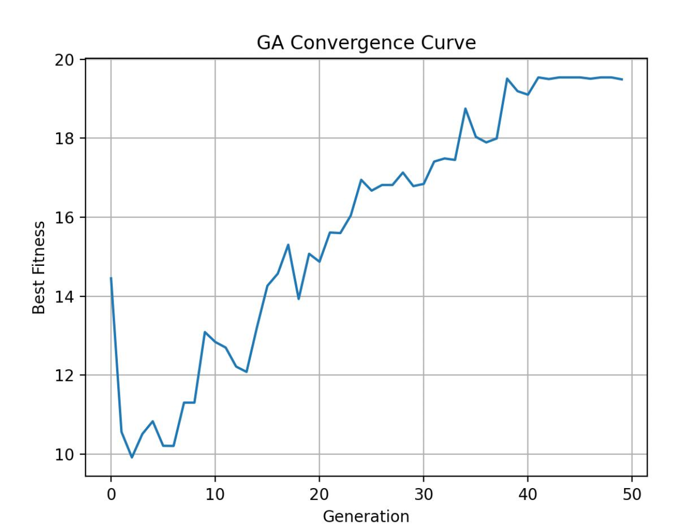
OUTPUT:

Slide 39
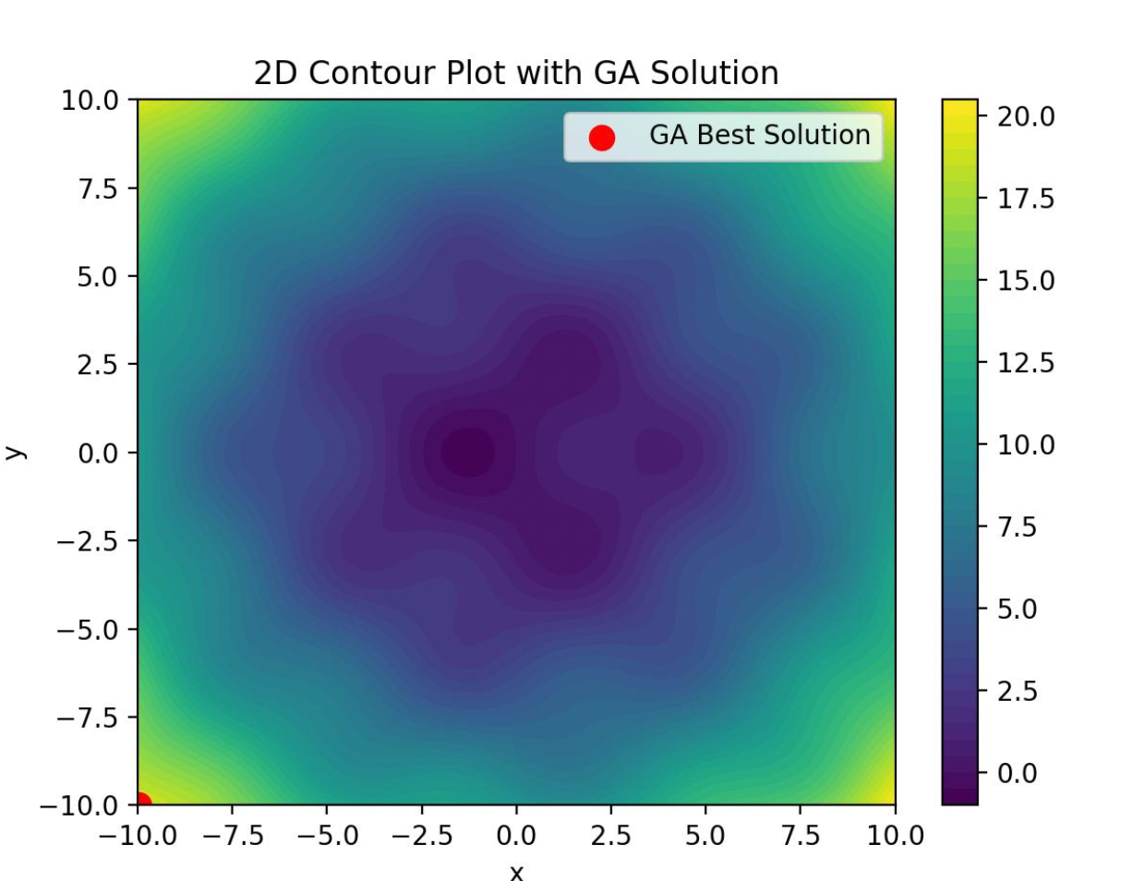
OUTPUT:

Slide 40
CONCLUSION
This project proposes the study and exploration of nature-inspired optimization algorithms such as Genetic Algorithm, Genetic Programming, Ant Colony Optimization, Differential Evolution, and Particle Swarm Optimization.
The project aims to understand how these techniques enable adaptive learning, intelligent search, and optimization in complex problem spaces. By analyzing their behavior and characteristics, the foundation is set for building an effective evolutionary optimization framework in later phases.
Overall, this work establishes a strong conceptual and design base for implementing and evaluating evolutionary optimization techniques in real-world applications.

Slide 41
Thank you for your time!
EVOLUTIONARY OPTIMIZATION , LEARNING AND ADAPTIVE SYSTEMS
CB.SC.U4CSE23042
CB.SC.U4CSE23016
CB.SC.U4CSE23223
CB.SC.U4CSE23212
CB.SC.U4CSE23202

